Slide 1

A Correspondence Between Projective Geometry and Circle Geometry
Opal Graham
Flash Talk
Spring 2019
Notes:
22 sec

Slide 2


Circle Space $𝒞(𝕊^{2})$

Slide 3
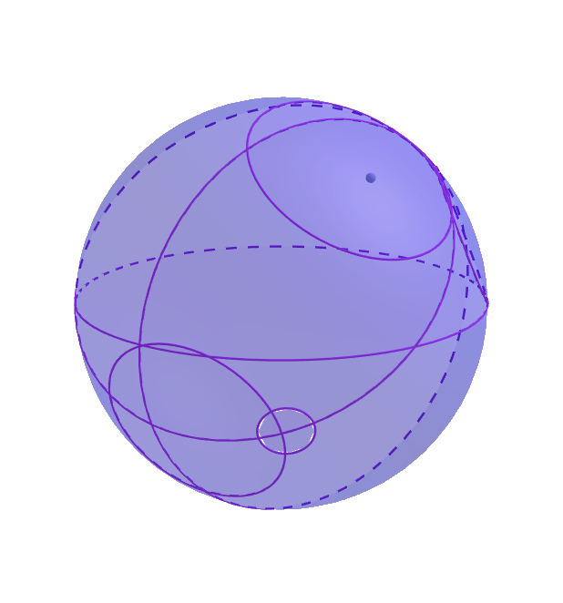

Circle Space $𝒞(𝕊^{2})$
Elements are circles of radius
$0≤r≤π$ in $𝕊^{2}$.

Slide 4

Projective Space $ℝℙ^{3}$

Slide 5

Projective Space $ℝℙ^{3}$
Elements are points
in $𝔼^{3}⋃ℝℙ^{2}$.

Slide 6
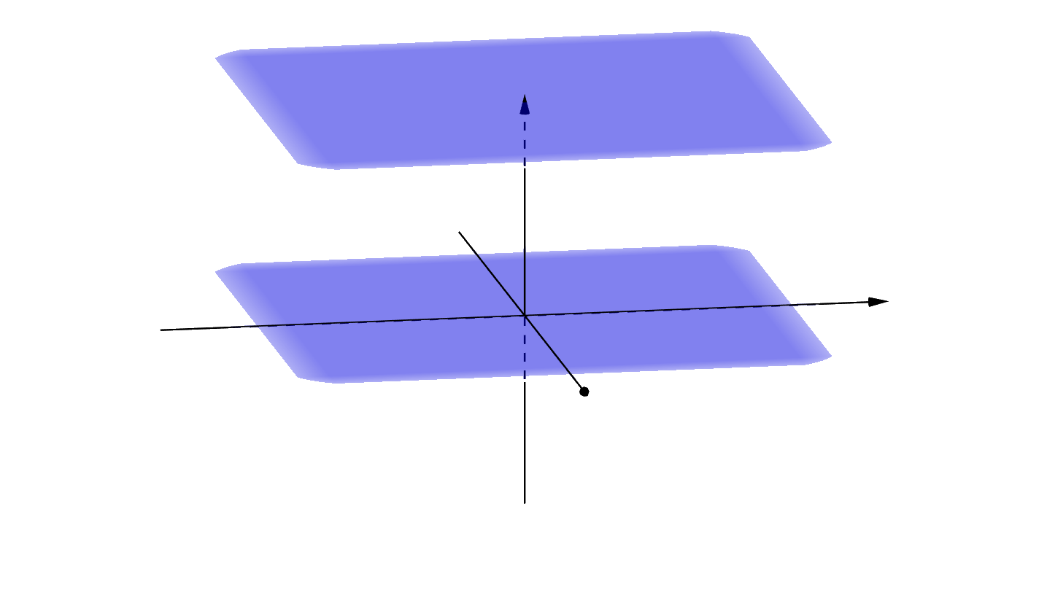

Projective Space $ℝℙ^{3}$
Elements are points
in $𝔼^{3}⋃ℝℙ^{2}$.
$$ℝ^{4}$$

Slide 7
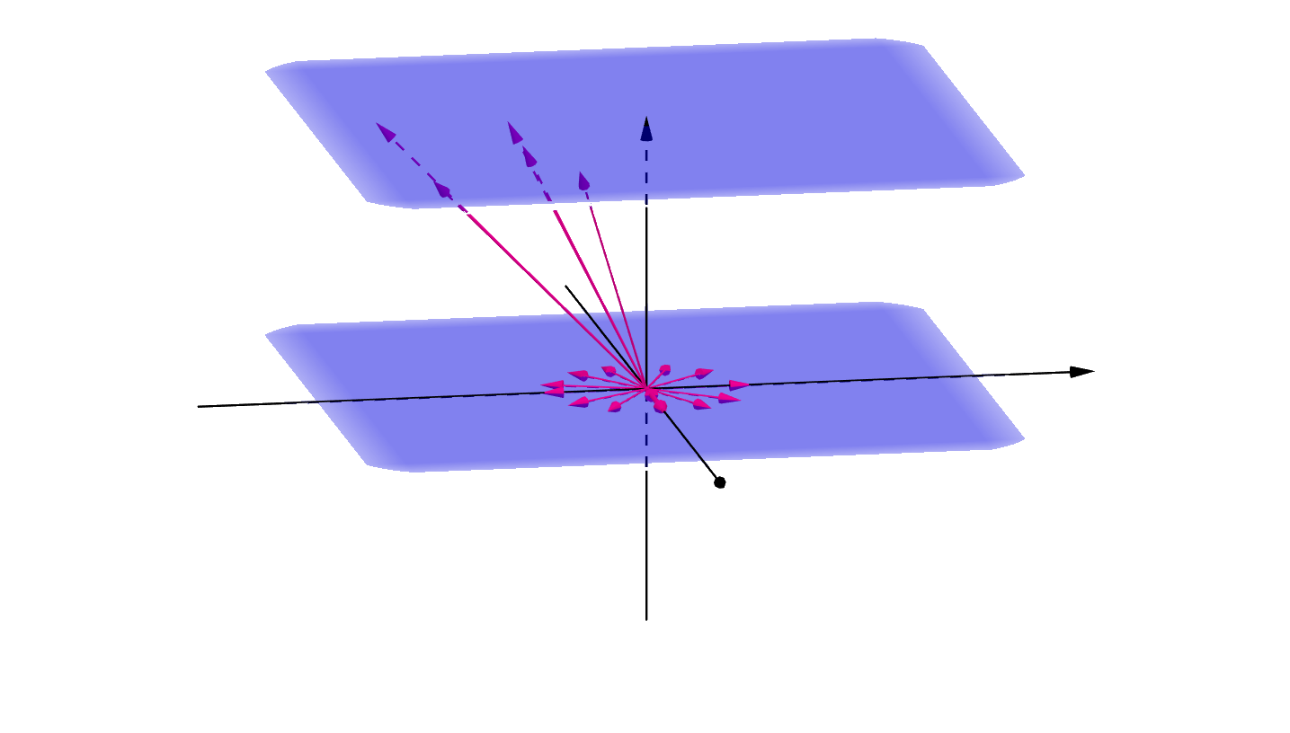
Projective Space $ℝℙ^{3}$
Elements are points
in $𝔼^{3}⋃ℝℙ^{2}$.
$$ℝ^{4}$$

Slide 8

Projective Space $ℝℙ^{3}$
Elements are points
in $𝔼^{3}⋃ℝℙ^{2}$.
$$𝔼^{3}$$
$$ℝ^{4}$$

Slide 9
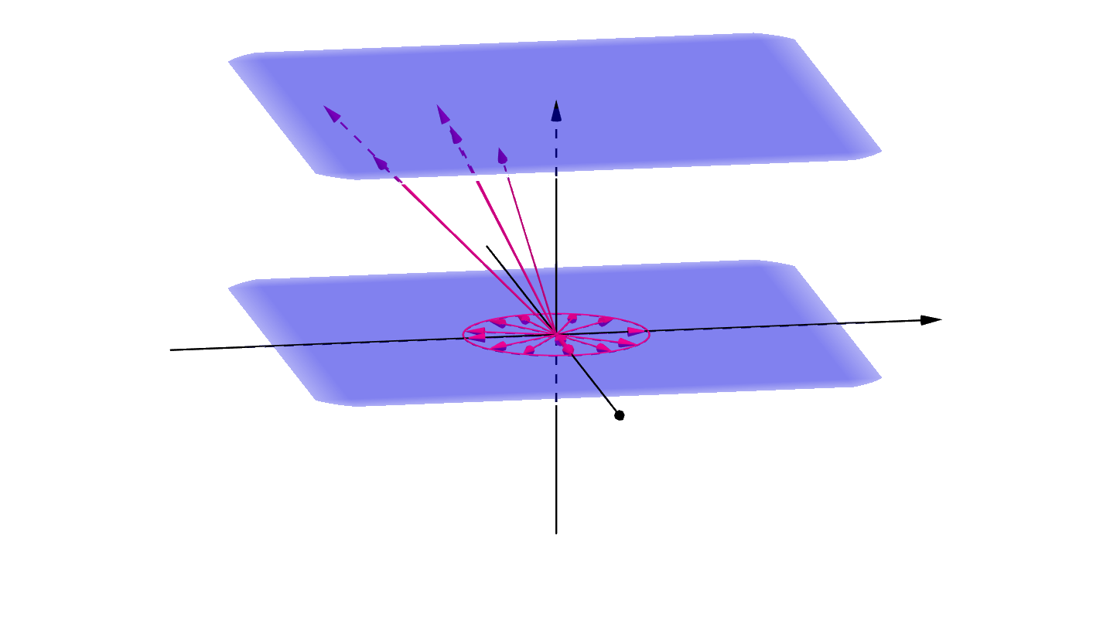

Projective Space $ℝℙ^{3}$
Elements are points
in $𝔼^{3}⋃ℝℙ^{2}$.
$$𝔼^{3}$$
$$ℝ^{4}$$
$$ℝℙ^{2}$$

Slide 10



Projective Space $ℝℙ^{3}$
Elements are points
in $𝔼^{3}⋃ℝℙ^{2}$.
Circle geometry is a subgeometry of projective geometry.
$$𝕊^{2}$$
$$𝔼^{3}$$
$$ℝ^{4}$$
$$ℝℙ^{2}$$

Slide 11

c-Points

Slide 12


c-Points $→$ Projective Planes

Slide 13


c-Points $→$ Projective Planes

Slide 14
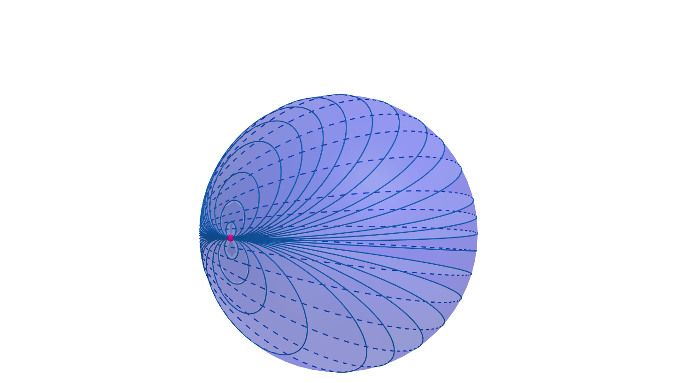
c-Lines

Slide 15
c-Lines
1. Intersect at one point

Slide 16
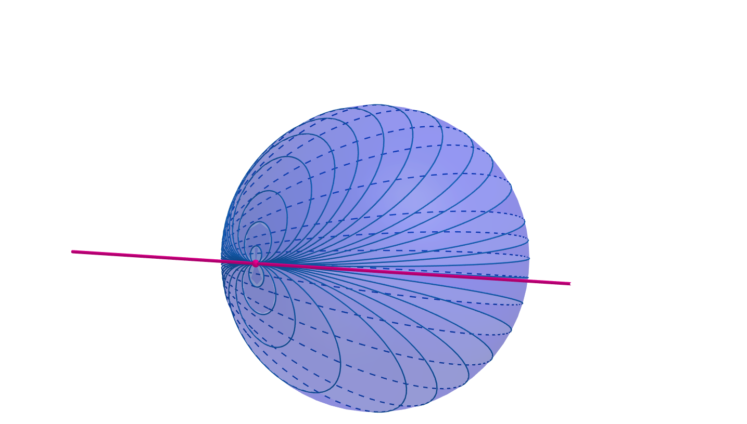


c-Lines $↔$ Projective Lines
1. Intersect at one point
Tangent to $𝕊^{2}$ at point

Slide 17
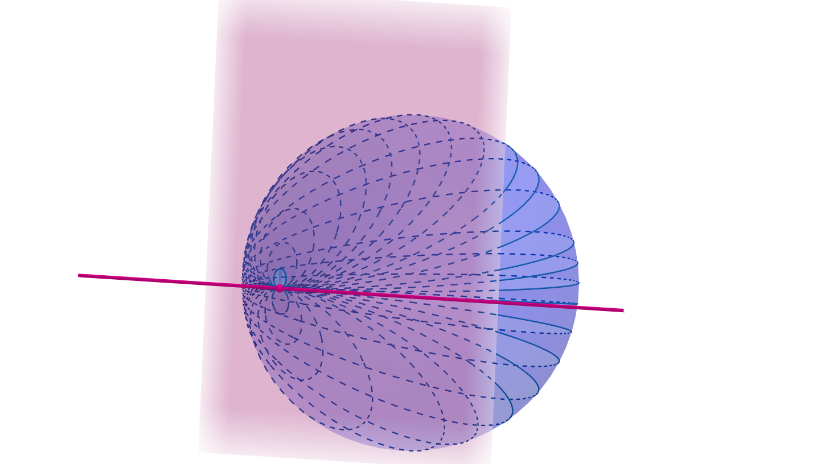
c-Lines $↔$ Projective Lines
1. Intersect at one point
Tangent to $𝕊^{2}$ at point

Slide 18
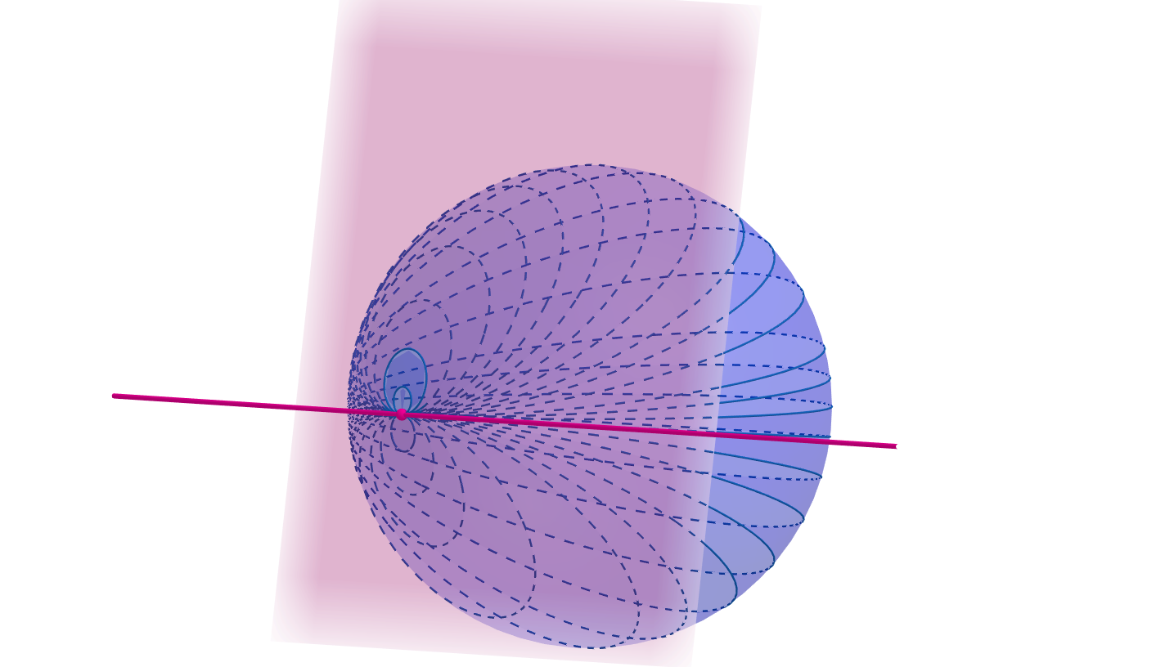
c-Lines $↔$ Projective Lines
1. Intersect at one point
Tangent to $𝕊^{2}$ at point

Slide 19
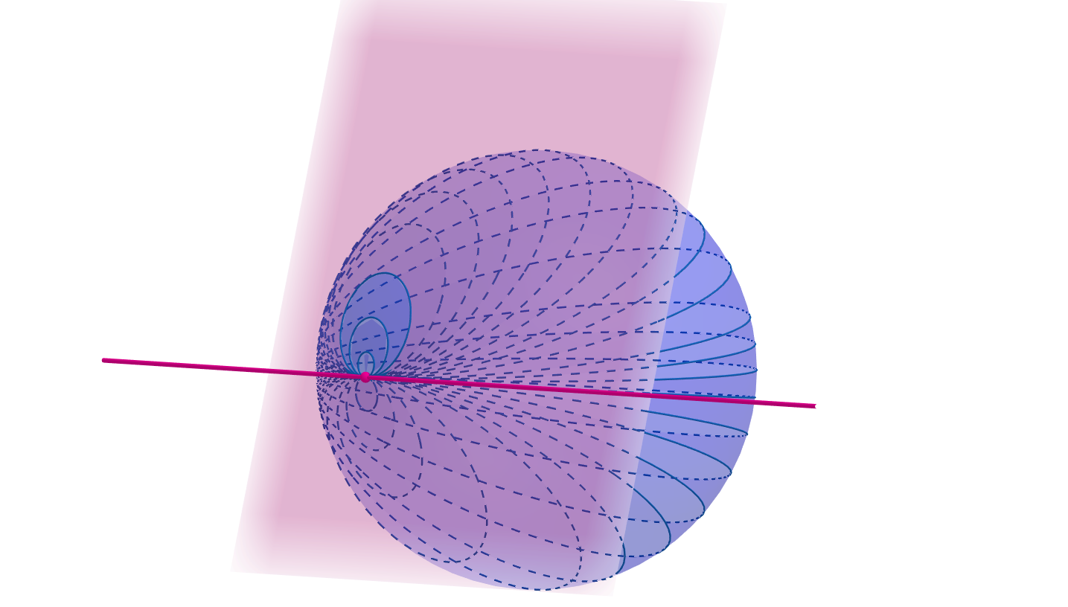
c-Lines $↔$ Projective Lines
1. Intersect at one point
Tangent to $𝕊^{2}$ at point

Slide 20
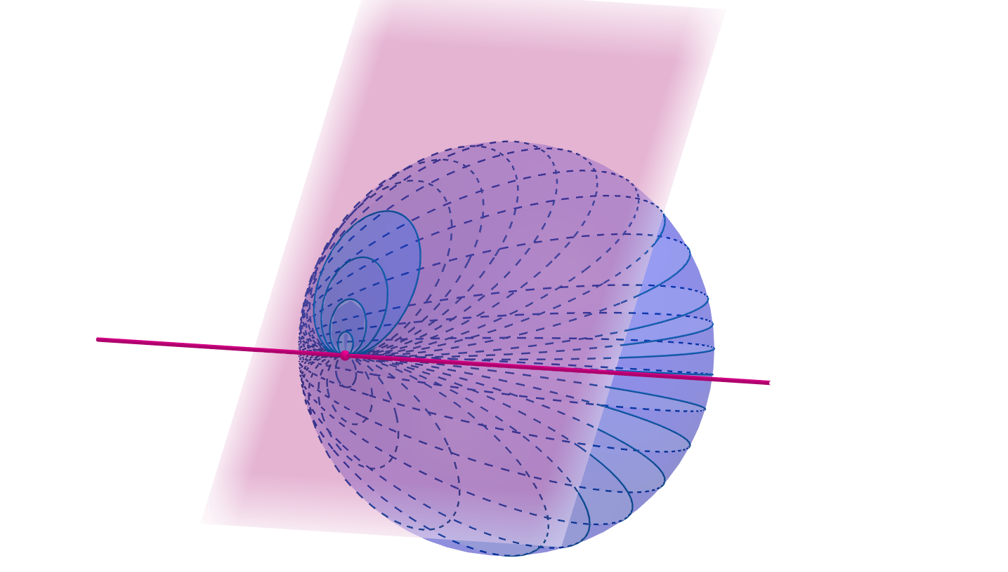
c-Lines $↔$ Projective Lines
1. Intersect at one point
Tangent to $𝕊^{2}$ at point

Slide 21
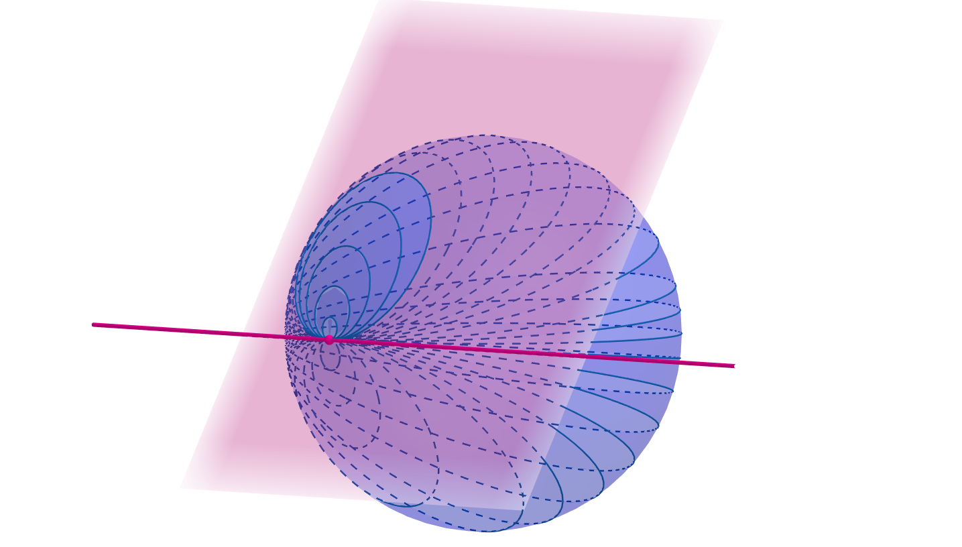
c-Lines $↔$ Projective Lines
1. Intersect at one point
Tangent to $𝕊^{2}$ at point

Slide 22
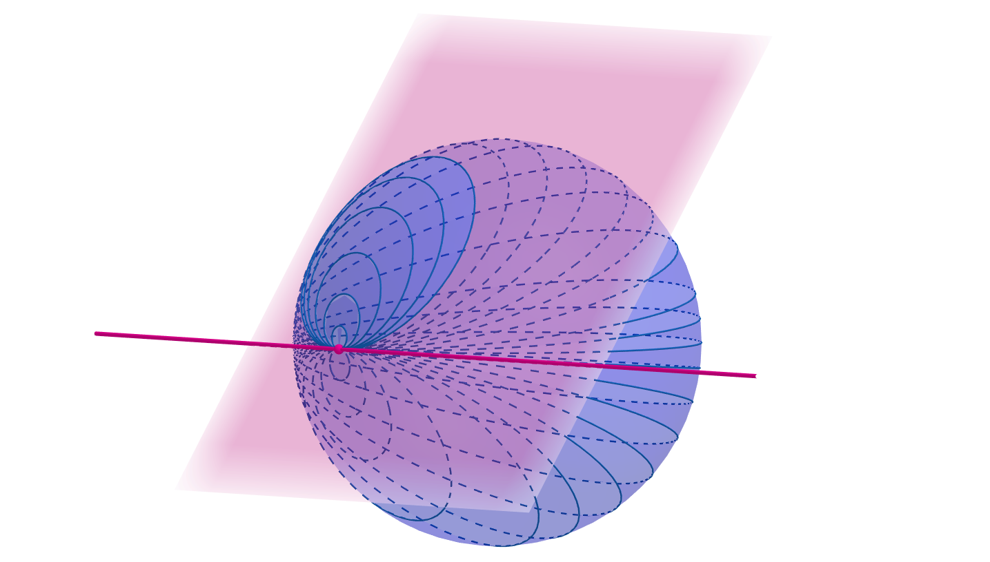
c-Lines $↔$ Projective Lines
1. Intersect at one point
Tangent to $𝕊^{2}$ at point

Slide 23
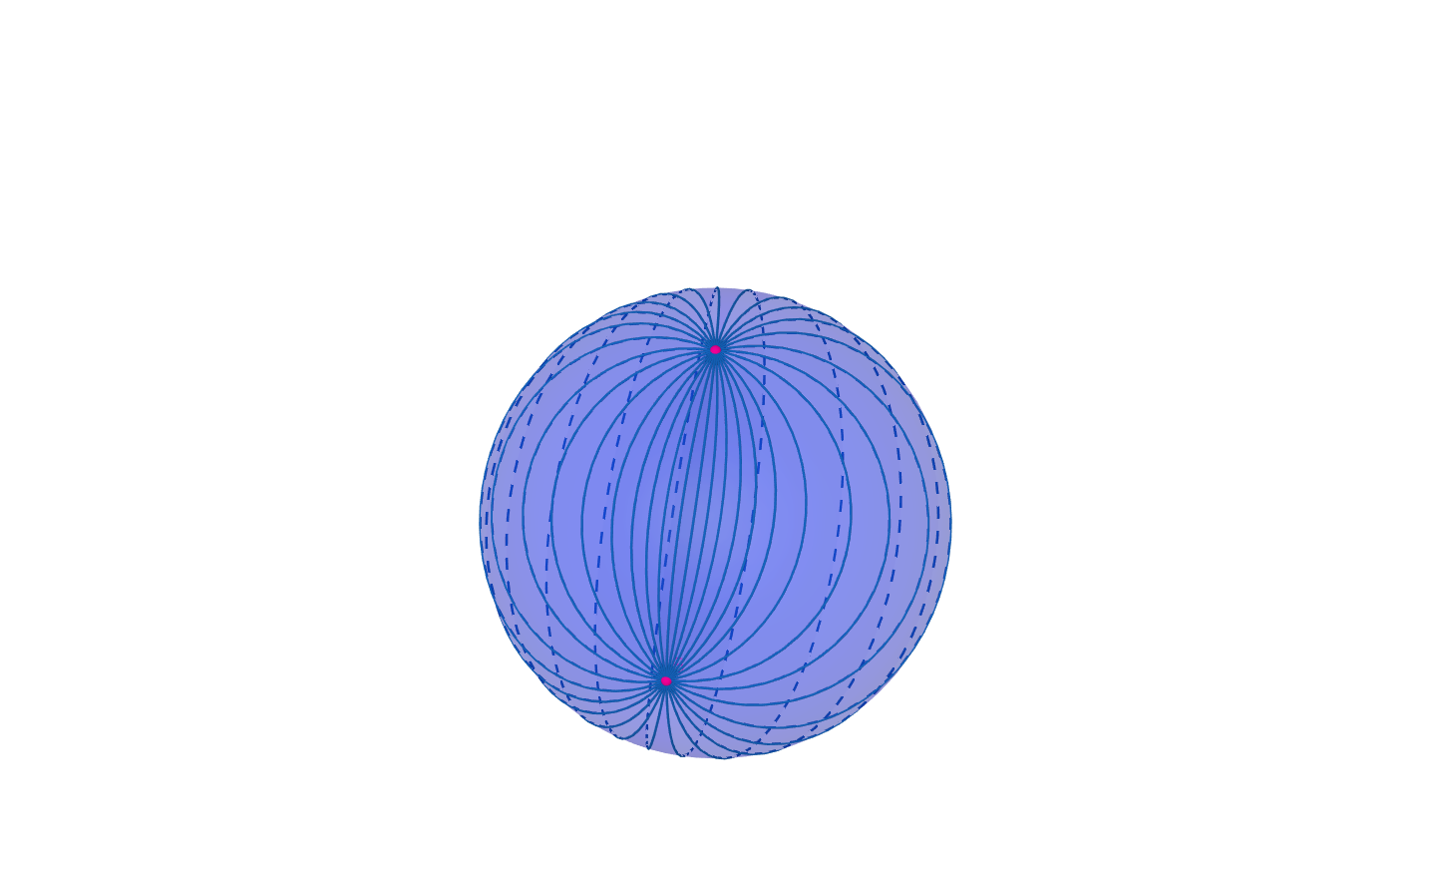
c-Lines $↔$ Projective Lines
2. Intersect at two points

Slide 24
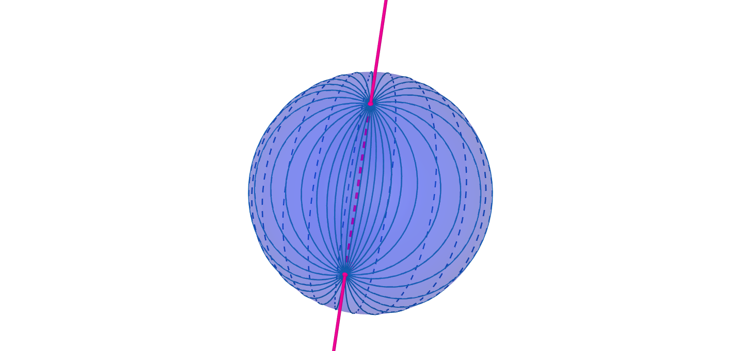

c-Lines $↔$ Projective Lines
2. Intersect at two points
Intersects $𝕊^{2}$ at two points

Slide 25
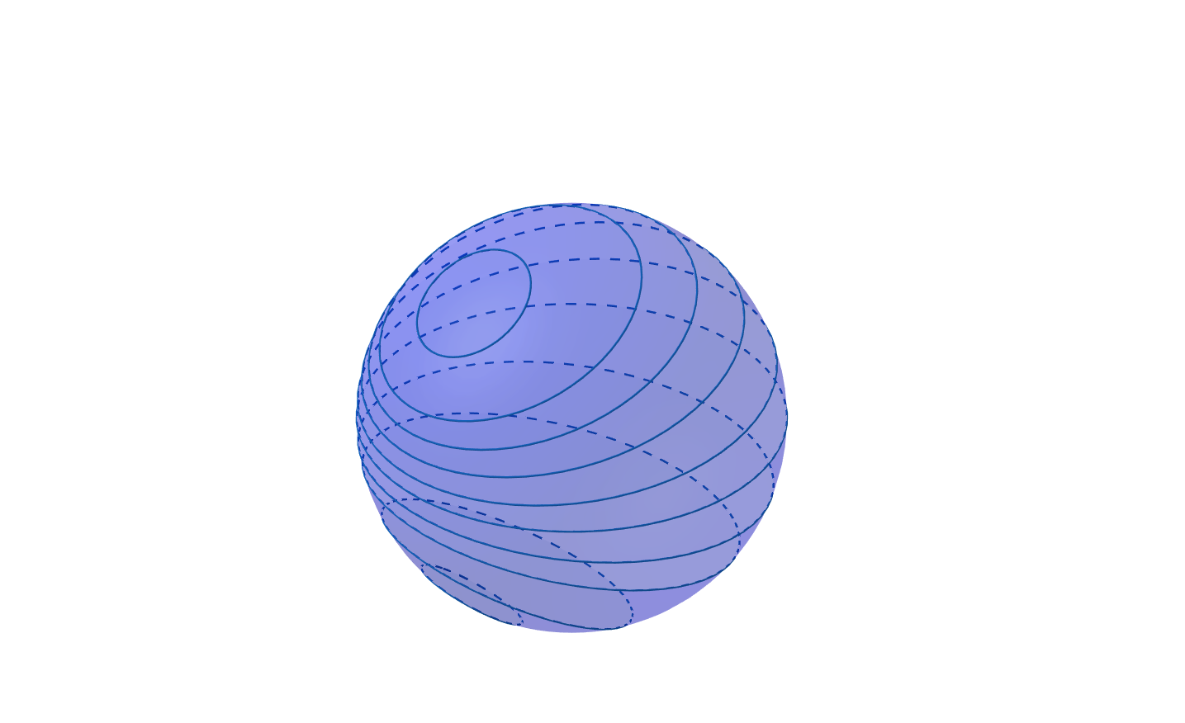
c-Lines $↔$ Projective Lines
3. Don’t intersect

Slide 26
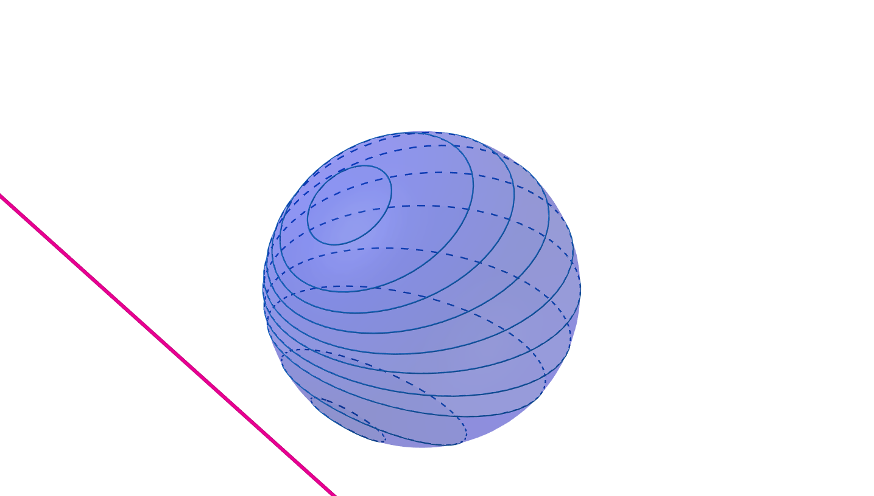

c-Lines $↔$ Projective Lines
3. Don’t intersect
Doesn’t intersect $𝕊^{2}$.

Slide 27
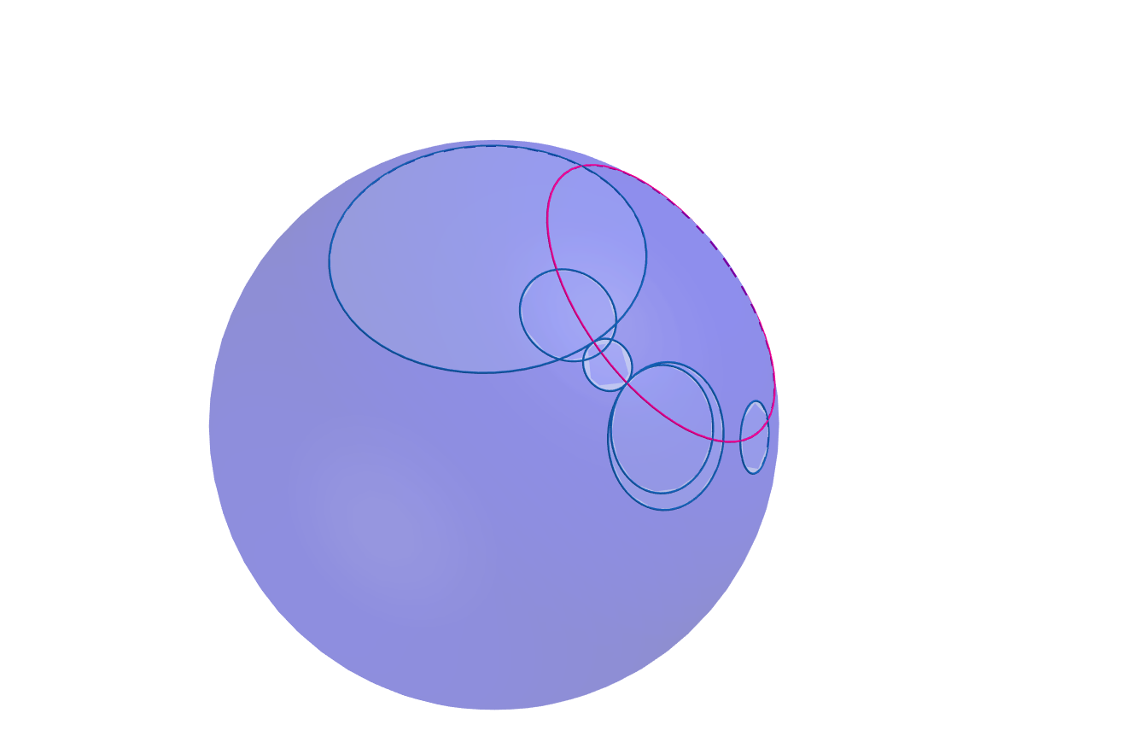
c-Planes

Slide 28
c-Planes
1. All circles orthogonal to generating circle

Slide 29


c-Planes $↔$ Projective Points
1. All circles orthogonal to generating circle
Point outside sphere

Slide 30
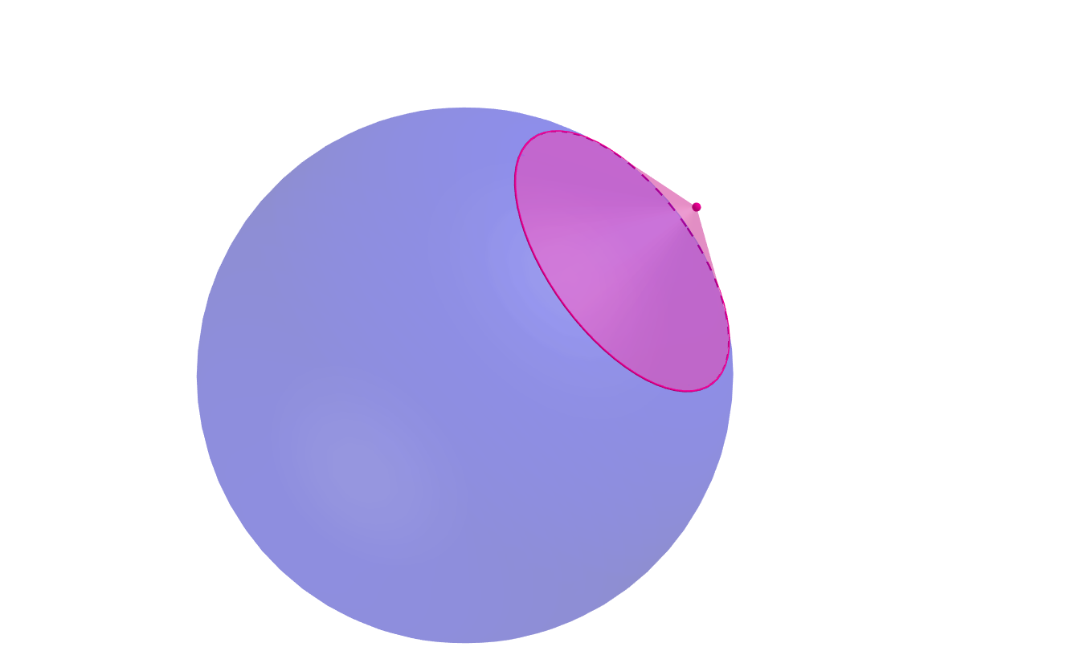
c-Planes $↔$ Projective Points
1. All circles orthogonal to generating circle
Point outside sphere

Slide 31
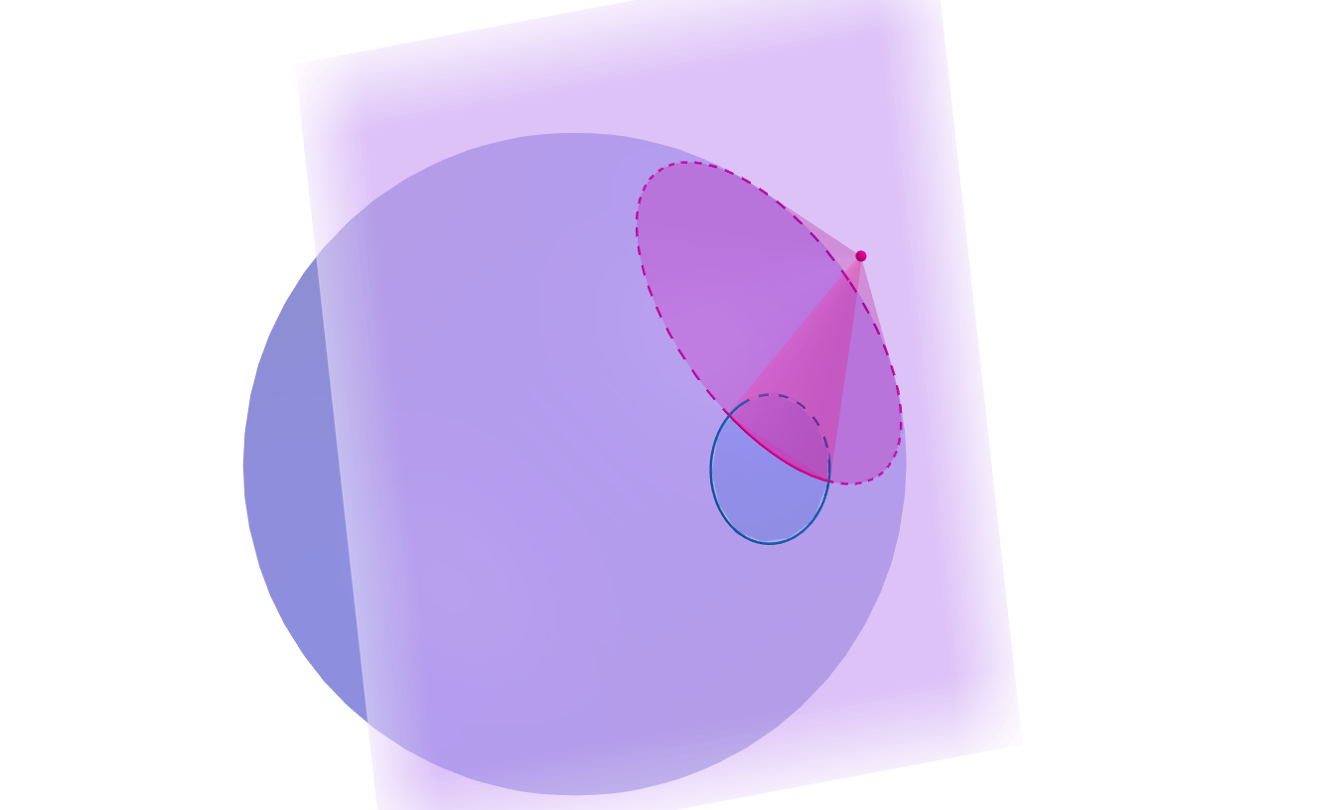
c-Planes $↔$ Projective Points
1. All circles orthogonal to generating circle
Point outside sphere

Slide 32
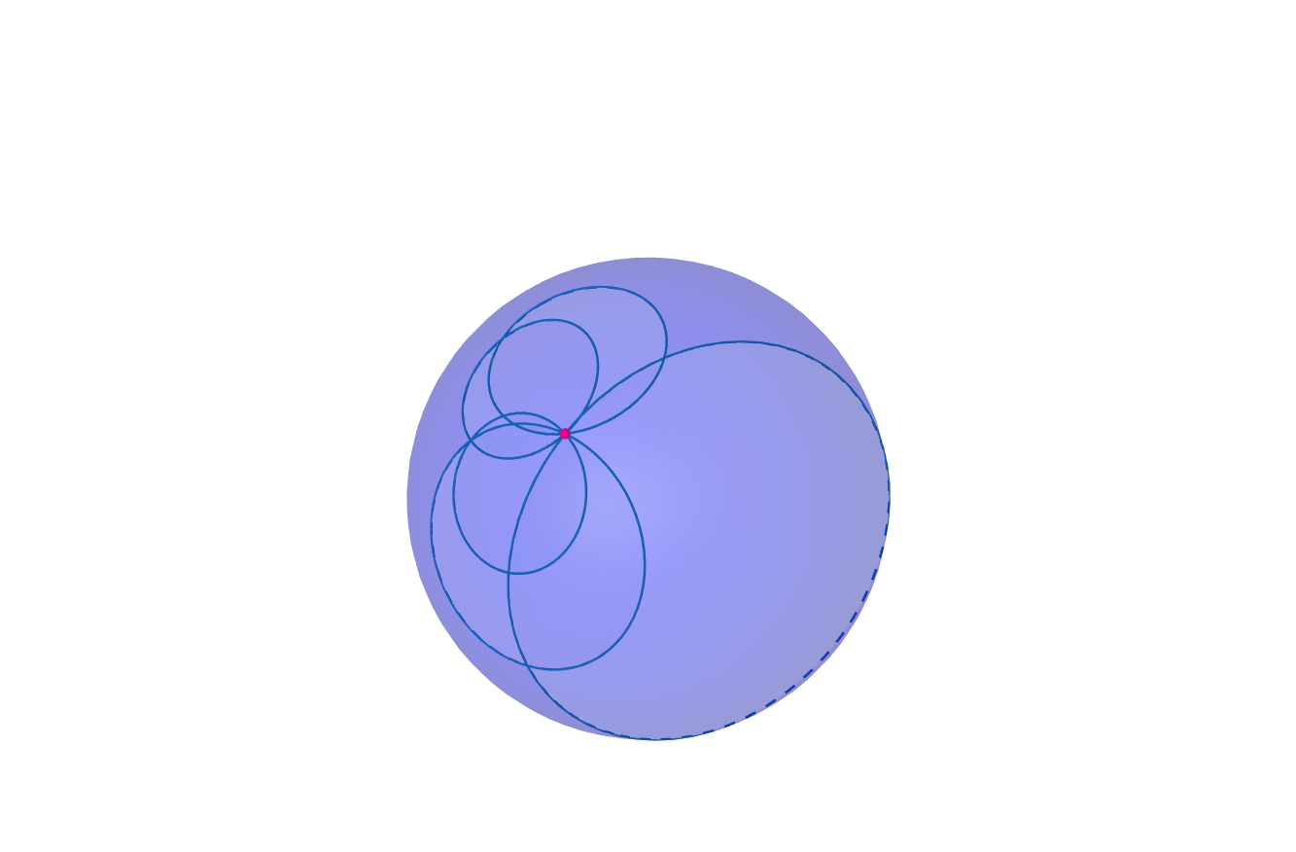
c-Planes $↔$ Projective Points
2. All circles through generating “circle”

Slide 33
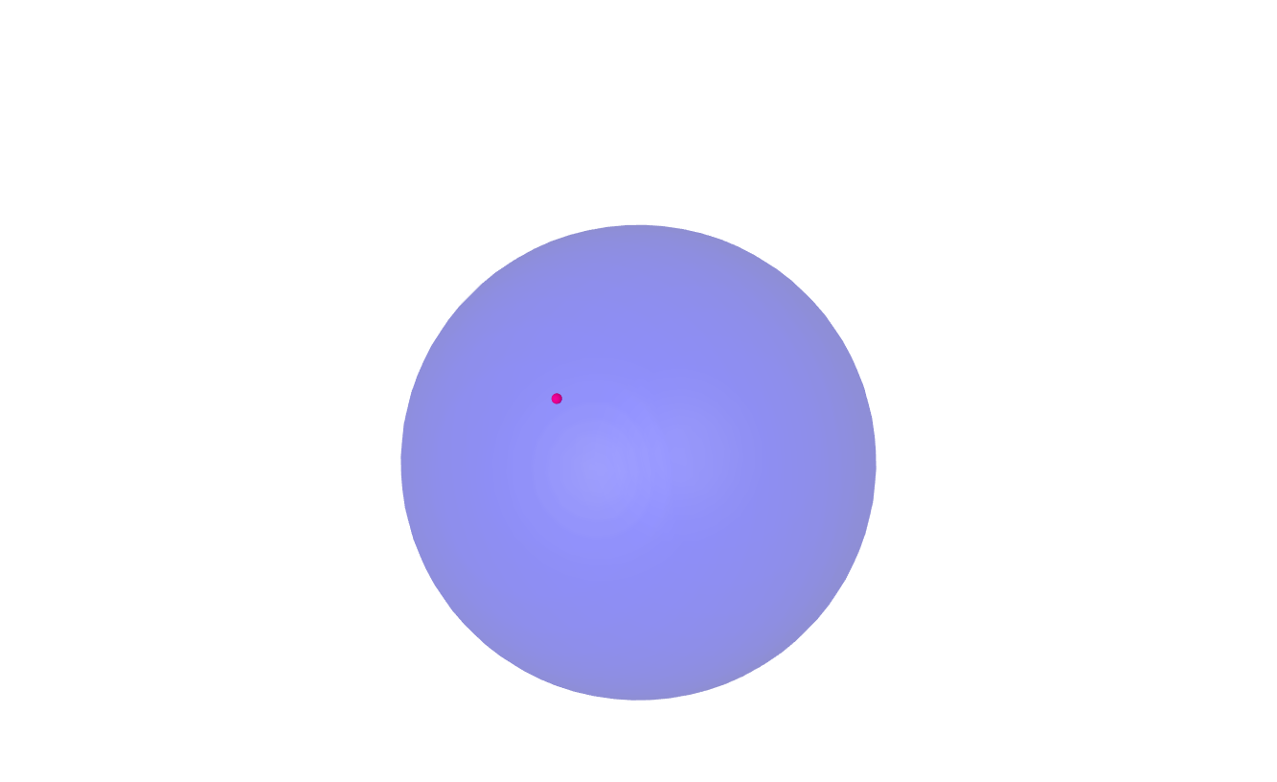
c-Planes $↔$ Projective Points
2. All circles through generating “circle”
Point on sphere

Slide 34
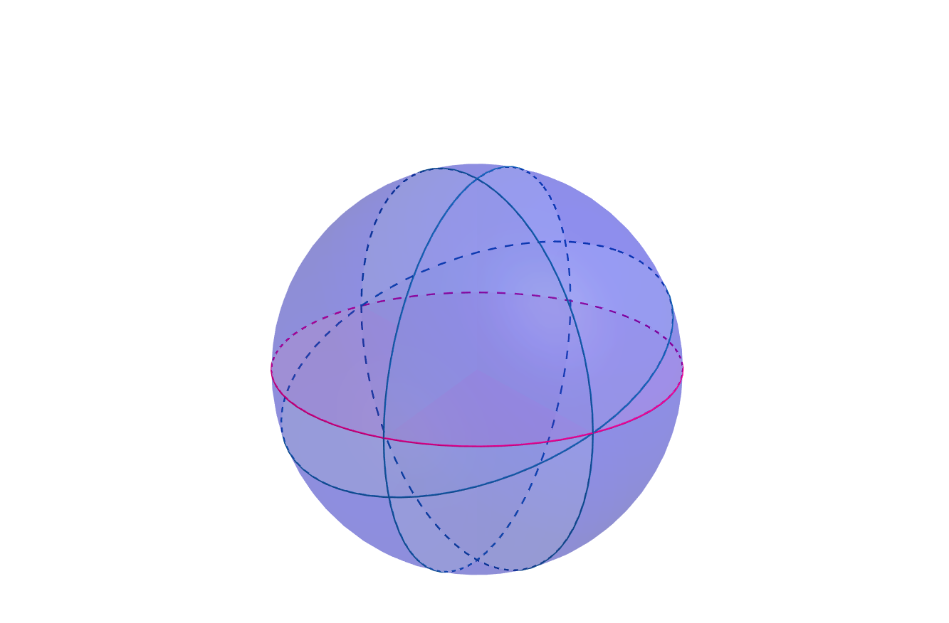
c-Planes $↔$ Projective Points
3. All circles through antipodal points on generating circle

Slide 35
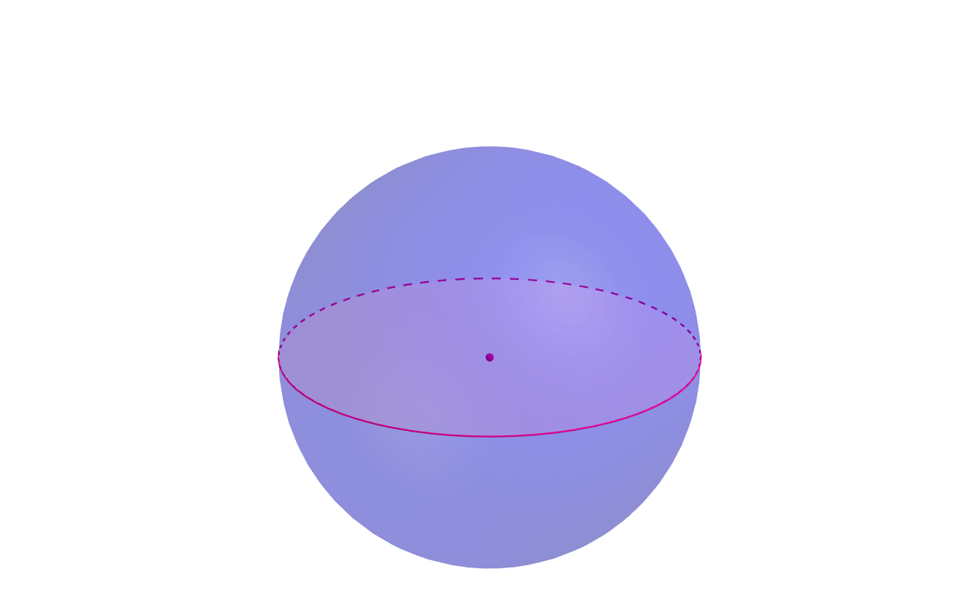
c-Planes $↔$ Projective Points
3. All circles through antipodal points on generating circle
Point inside sphere

Slide 36
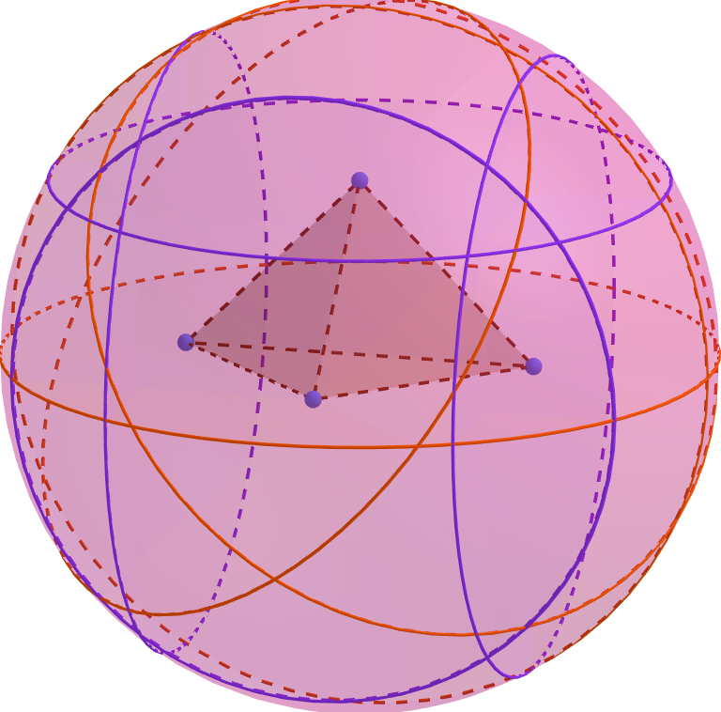

c-Polyhedra $↔$ Projective Polyhedra

Slide 37
c-Polyhedra $↔$ Projective Polyhedra
▲Hyperbolic polyhedra :
Andre’ev (‘70)
Rivin & Hodgson (‘93)

Slide 38
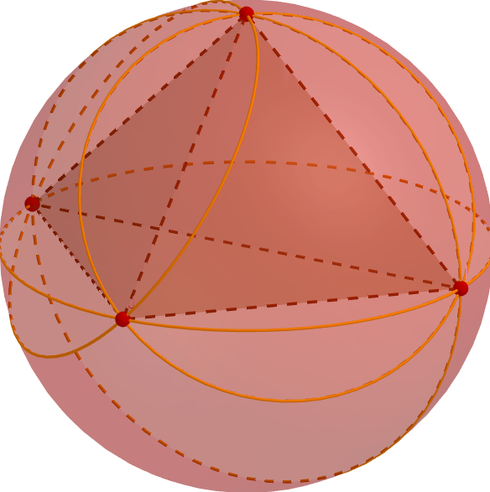
c-Polyhedra $↔$ Projective Polyhedra
Ideal Polyhedra:
Rivin (‘96) ▼
▲Hyperbolic polyhedra :
Andre’ev (‘70)
Rivin & Hodgson (‘93)

Slide 39
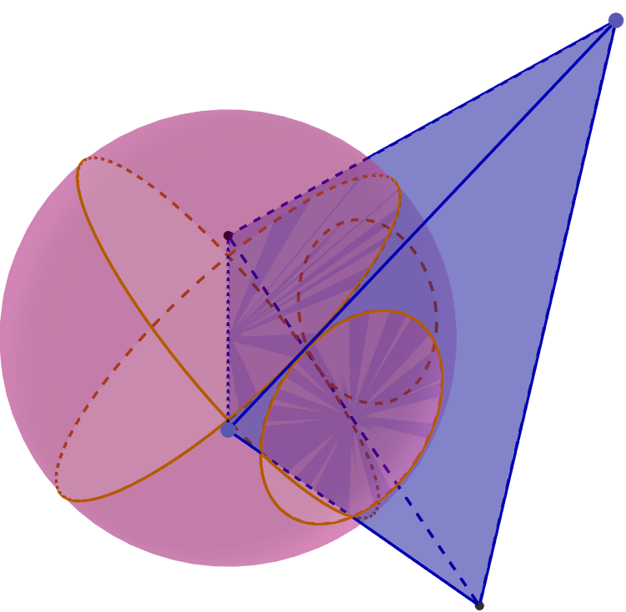
c-Polyhedra $↔$ Projective Polyhedra
Ideal Polyhedra:
Rivin (‘96) ▼
▲Hyperbolic polyhedra :
Andre’ev (‘70)
Rivin & Hodgson (‘93)
▲ Hyperideal polyhedra :
Bao & Bonahon (‘02)
Bowers, Bowers, Pratt (‘17)

Slide 40
“All Geometry is Projective Geometry.” Arthur Cayley

Slide 41
“All Geometry is Projective Geometry.” Arthur Cayley
Thank You!

Slide 42
Duality

Slide 43

Duality
c-points $↔$ projective points

Slide 44

Duality
c-points $↔$ projective points
c-lines $↔$ projective lines

Slide 45

Duality
c-points $↔$ projective points
c-lines $↔$ projective lines
c-planes $→$ projective planes

